Slide 1


ROS Workshop 2: Application
Robot Operating System
Notes:
Introduce yourself:
- EEE/4
- MLDA acads
- MLDA robotics

Slide 2


MLDA@EEE - Our Mission
Provide an integrated platform for EEE/IEM students to learn and implement Machine Learning, Data Science & AI, as well as facilitate connections with the industry.
Training Area with CYNAP Core system for collaboration and presentation
MLDA@EEE
FYP/DIP/URECA
Industry Projects
>17 Workshops
>1000 Trained ML practitioners
>10 Academic Projects
>30 Industry projects
>5 competition
>15 Industry Partners
18 AIO workstations
6 Deep Learning Workstations, 4 Nvidia GTX 1080i cards each
ML Career Kickstart
events
Ample space for project work
GPU Servers (4 x V100 + 6 x V100) and storage server
Workshops
&
Competition
Notes:
MLDA@EEE is a student centric lab (run mainly by students, for students)
We aim to provide a platform to empower our EEE/IEM students in learning and deploying ML and data analytics skills in both academia and industry (so to facilitate *you* in learning ML and data analytics)
However we do not just reserve ourselves to EEE/IEM students, others are welcome too
We aim to achieve this through help of our SOTA faculty, resources, and technical support, and through 4 different pillars of events ranging from our ML projects, industry projects (we partner with industry), career events, workshops, and competition.
If you wanna learn more about MLDA please visit our social media at LinkedIn, Instagram, YouTube

Slide 3
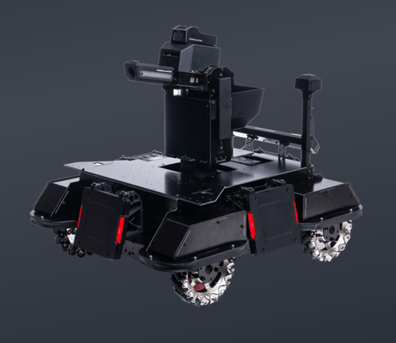
MLDA Robotics
New initiative from MLDA@EEE
Robotics + deep learning!
Activities:
Workshops
Projects (e.g. Tello drone project)
Competition
https://www.robomaster.com/en-US/robo/icra
Notes:
Mention about RMUA!

Slide 4
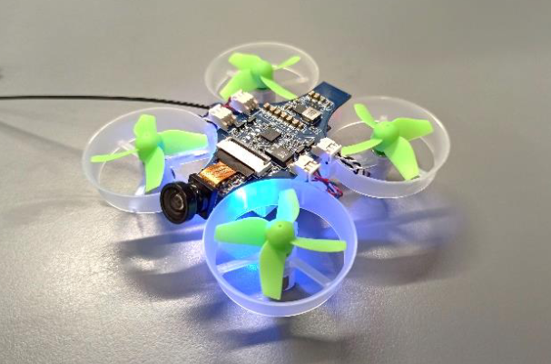
UAVionics Club
Notes:
Collaboration with UAVionics club
Some of the facils today are from UAVionics club
What they do: drones of course!

Slide 5
Flow of Today’s Workshop
Review of ROS concepts
ROS visualization concepts and tools
Concept of a simple controller
Hands-on session
Subscribing to sensor topics
Writing your own robot controller

Slide 6
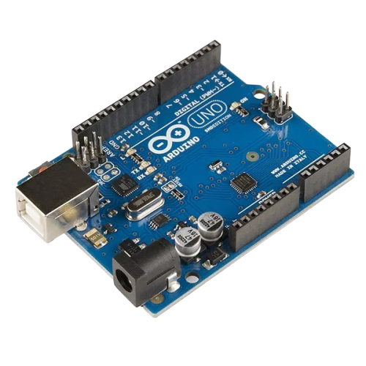
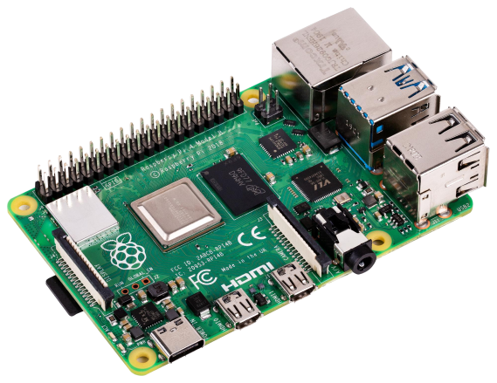

What is ROS?
Notes:
ROS is not a standalone OS, contrary to its name

Slide 7
What is ROS?
Computer (e.g. Raspberry Pi)
Operating System (e.g. Ubuntu)
ROS
Image processing
Navigation
ROS
Deep Learning
Localisation
Wheels and
Motor controller
Sensors
Notes:
ROS is a “middleware” for creating robot applications.
Runs on top of OS (normally Ubuntu)

Slide 8
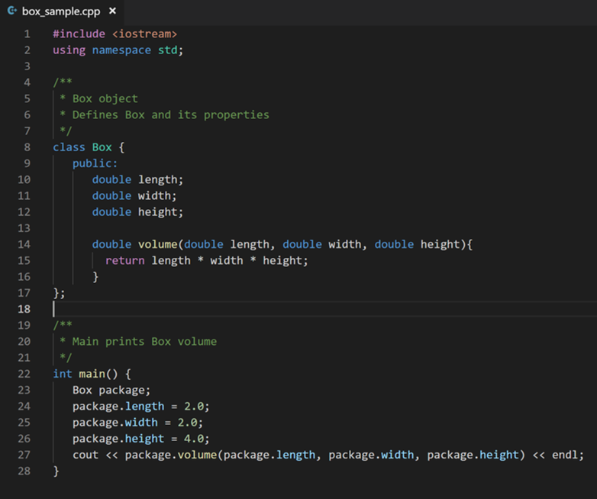
ROS
ROS
Master (roscore)
Navigation
Wheels and
Motor control
Sensors
Notes:
Coming back to our example here, we actually have ROS master running to allow these nodes to discover each other
ROS master is NOT a node!

Slide 9

ROS Topics & Messages
What is inside a typical ROS message?
Header (timestamp, sequence number, etc.)
Actual data content
Data format
ROS Topics
Name
Message type that it carries
Sender (publisher)
Receiver (subscriber)
Notes:
Topics are like actual letters they have a Name, a format, contents in it as well as a sender and receiver it will broadcast the messages but only if you subscribe to it you will receive it

Slide 10
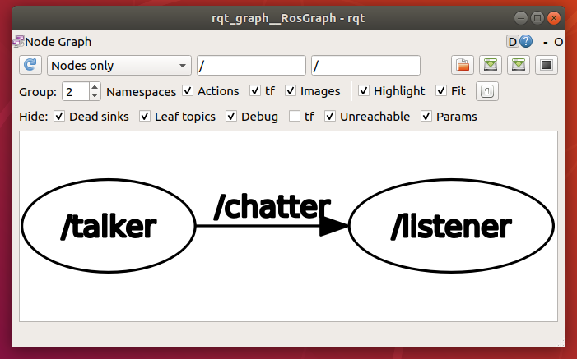
ROS Node & Topic: Example
Topic
Publisher
Subscriber

Slide 11
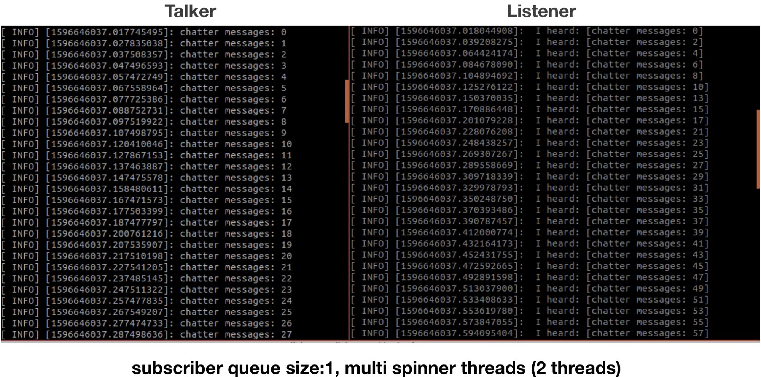
ROS Node & Topic: Example

Slide 12
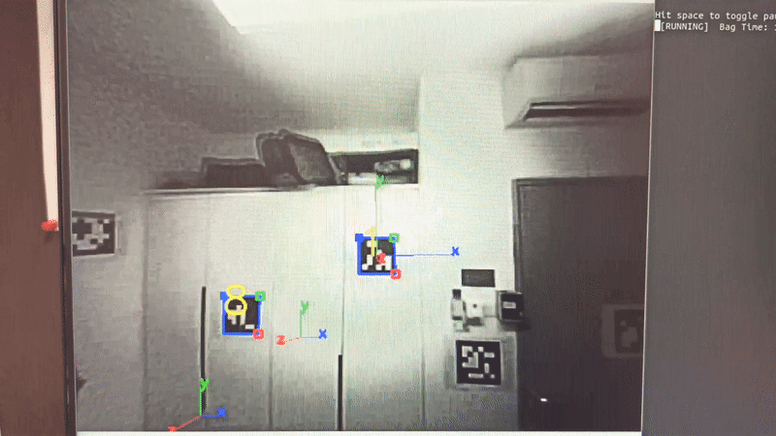
Applications
Notes:
FYI drone in this example is from UAVionics club

Slide 13
What’s special about ROS?
Open source; anyone can contribute!
Prebuilt packages for components, hardware drivers, sensors, algorithms, navigation, etc.
Large community & widespread use
Modular; integrate different individual parts and multiple people can work on different parts of the project at the same time
Streamline and standardized format of the data being sent
Allows communication with multiple other robots

Slide 14
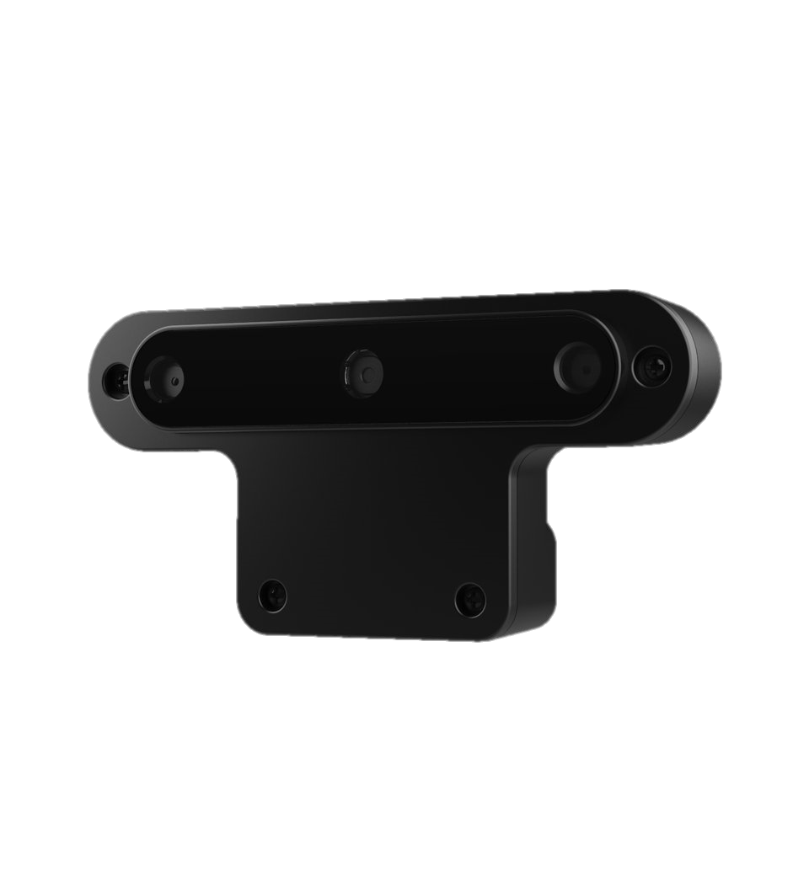
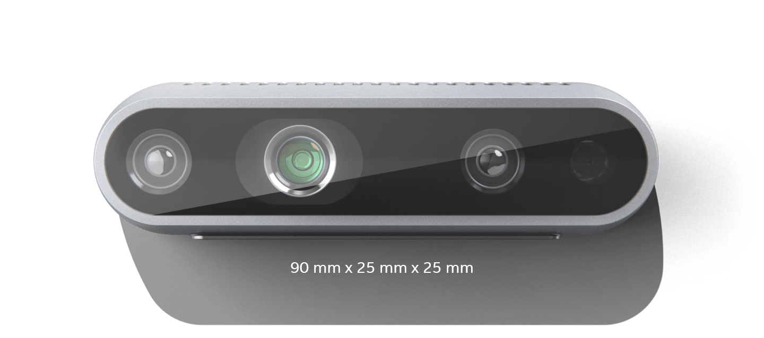
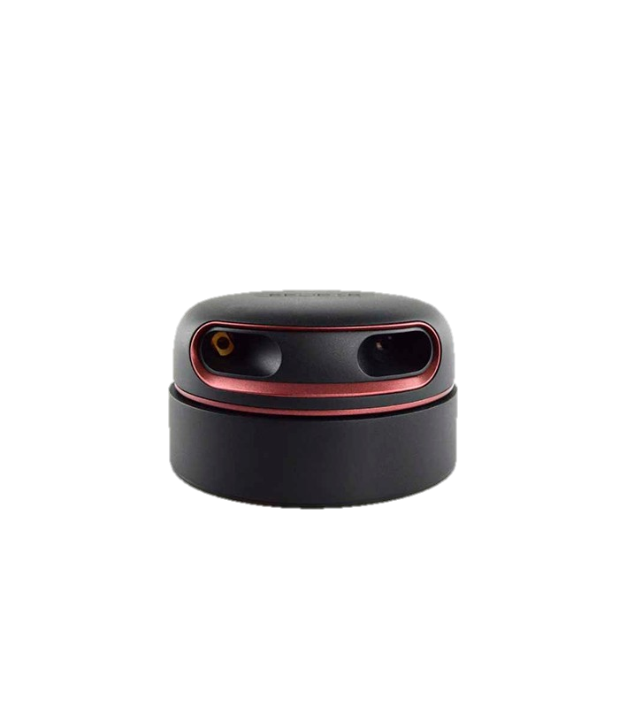
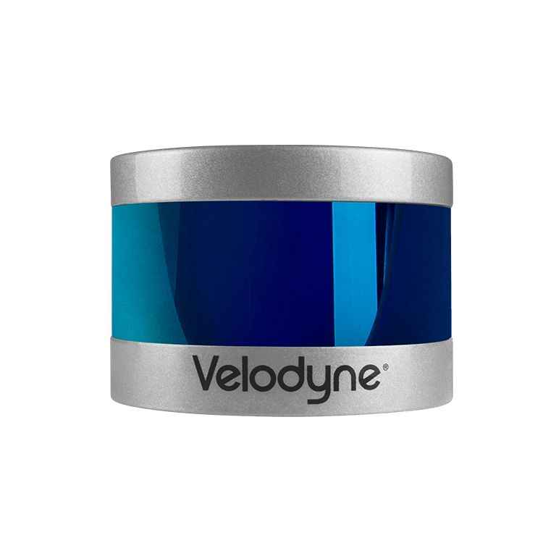
What’s special about ROS?
Intel RealSense D435
OAK-D
RPLIDAR A2
Velodyne LIDAR

Slide 15

Image data
Image can be represented with matrix of pixels with a given width(W) and height(H). (W x H x C)
Depending on the colorspace, image can have several channels:
A grayscale image has
a channel of 1 (C = 1)
A RGB image has a
channel of 3 (C = 3)

Slide 16
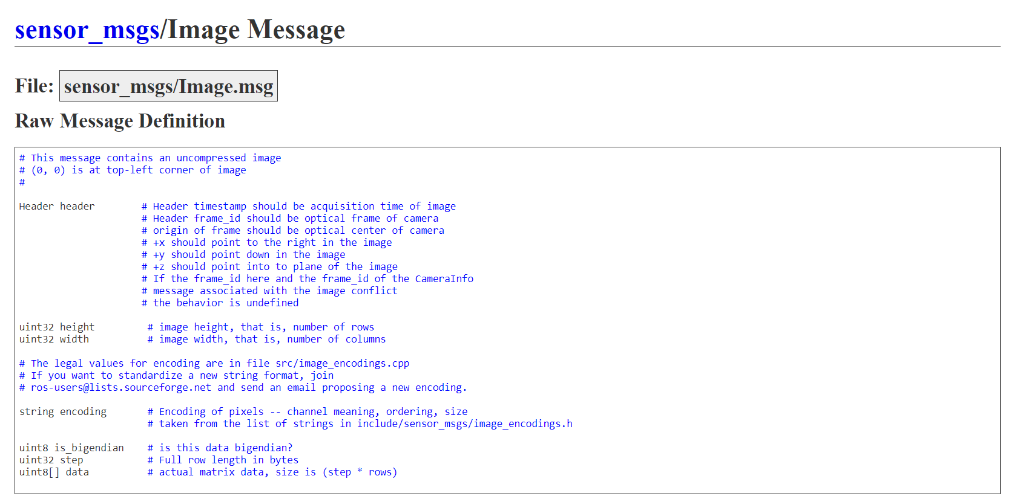
Image data

Slide 17
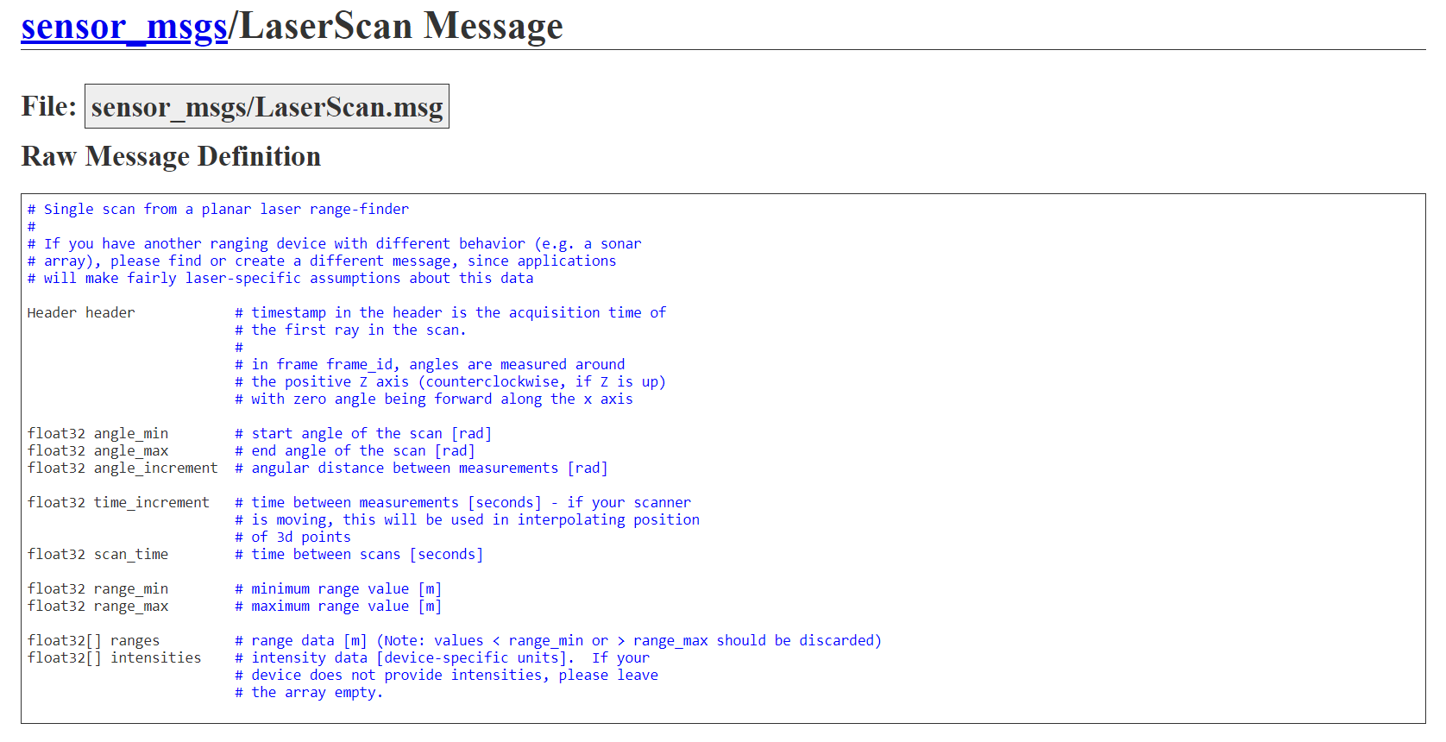
Laserscan message

Slide 18
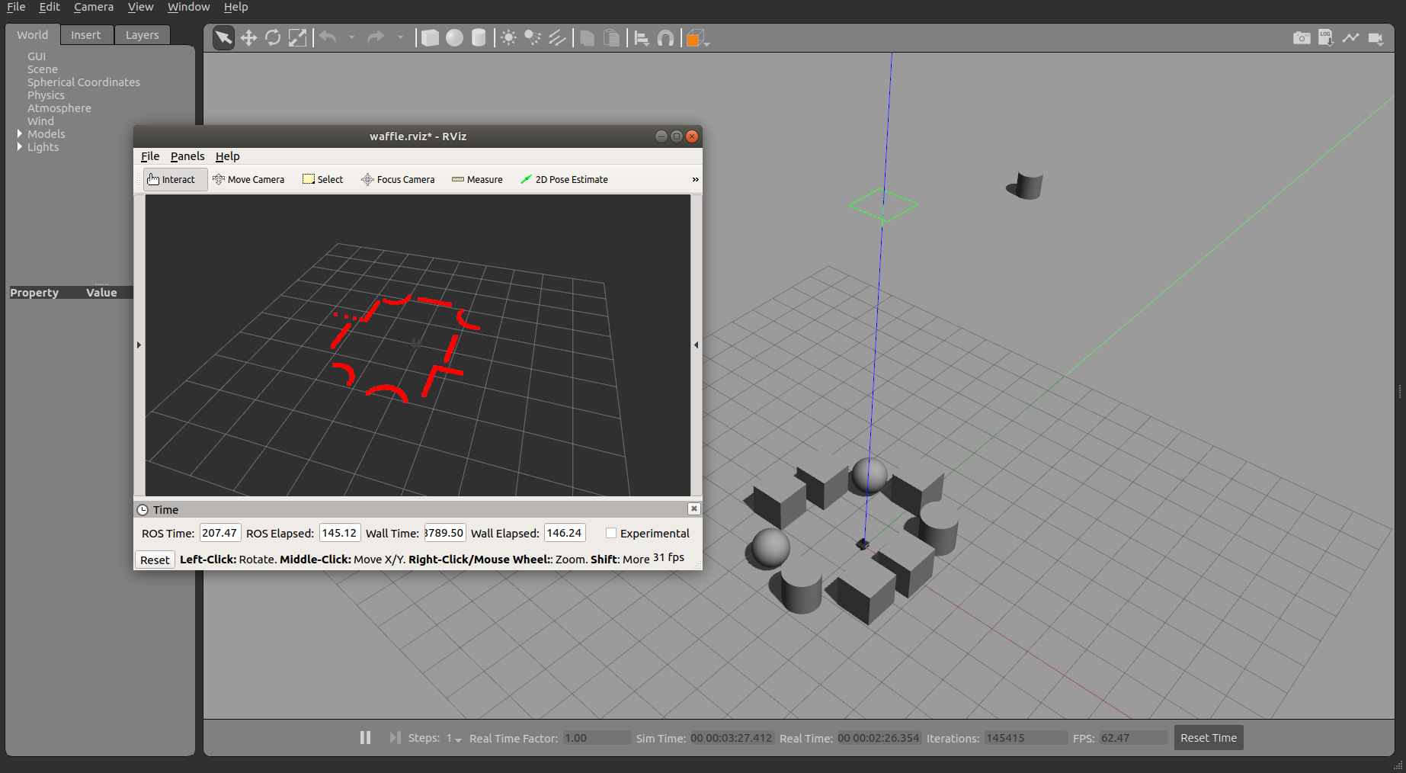
Laserscan message

Slide 19
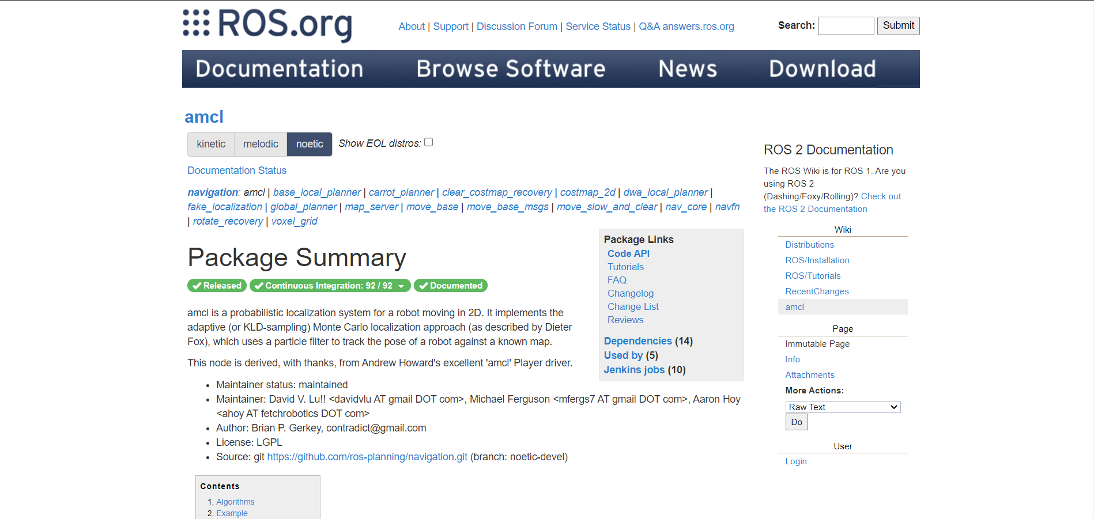
ROS package using laserscan

Slide 20
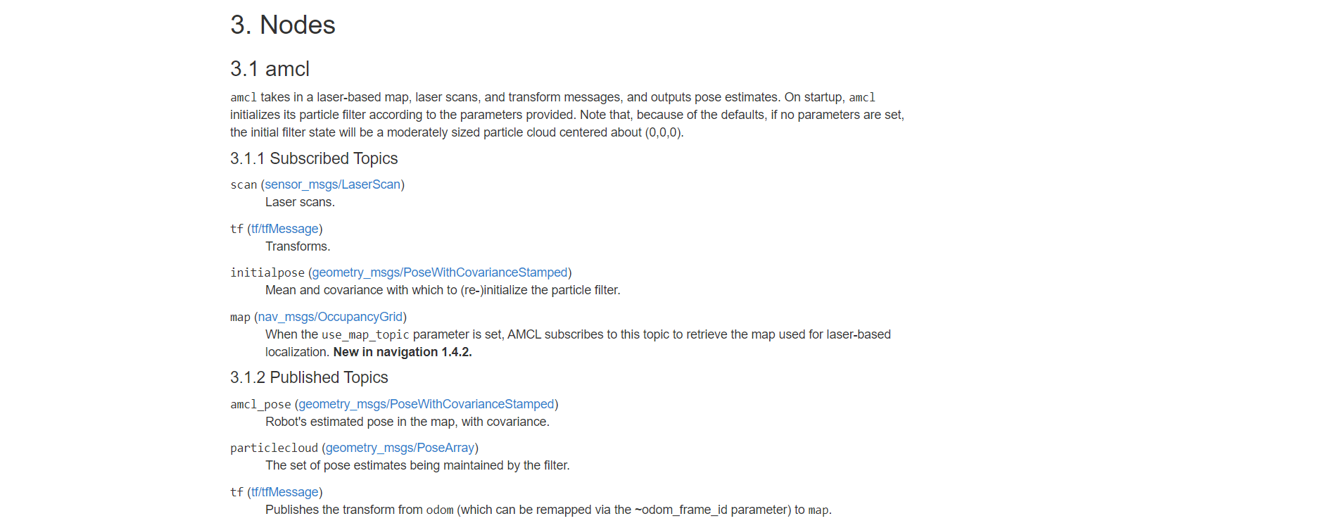
ROS package using laserscan

Slide 21
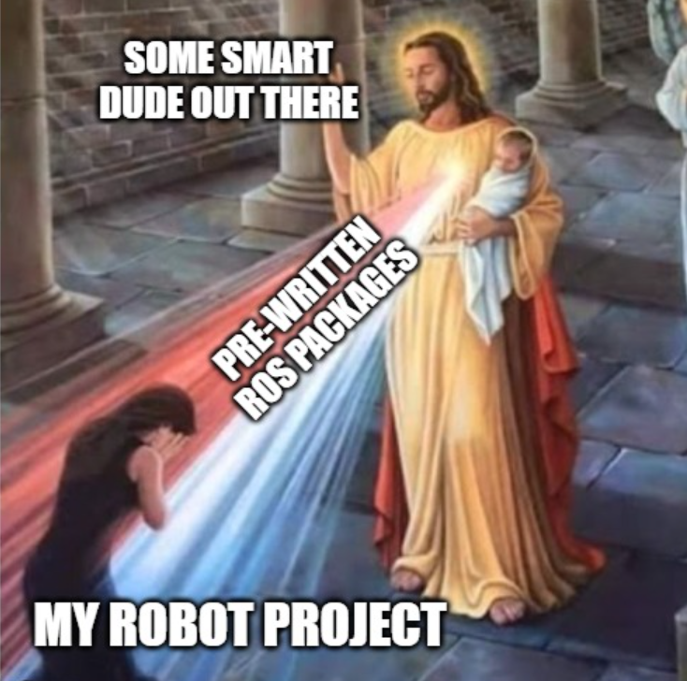
Notes:
Being modular and popular, you can often find the code for “components” of your robot already written by someone

Slide 22
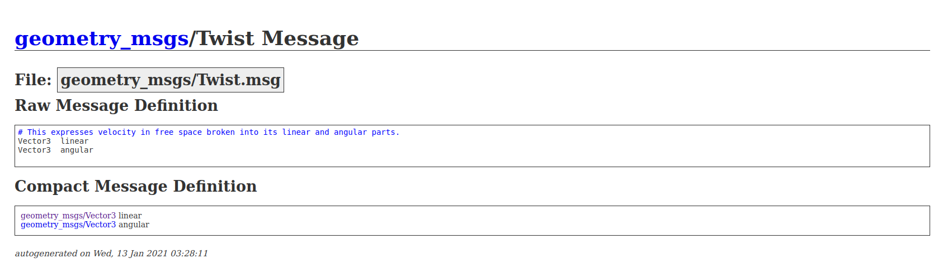
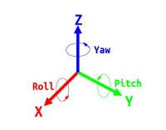
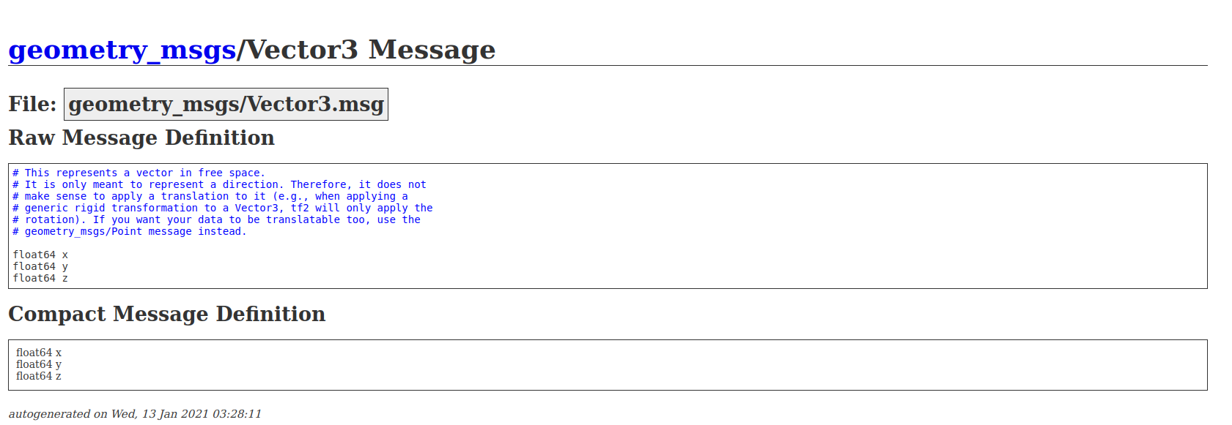
geometry_msgs/Twist.msg

Slide 23
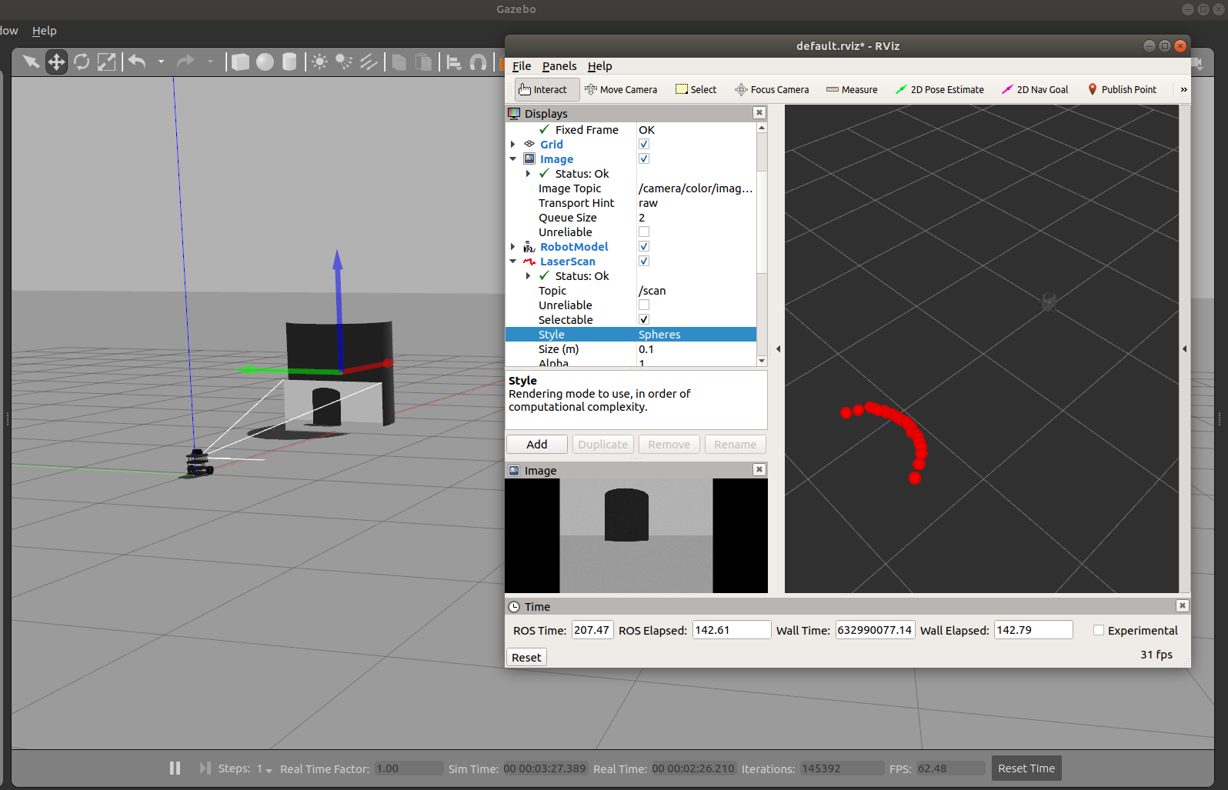
RVIZ

Slide 24
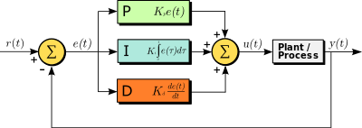
Concept of PID
A control mechanism that uses feedback

Slide 25
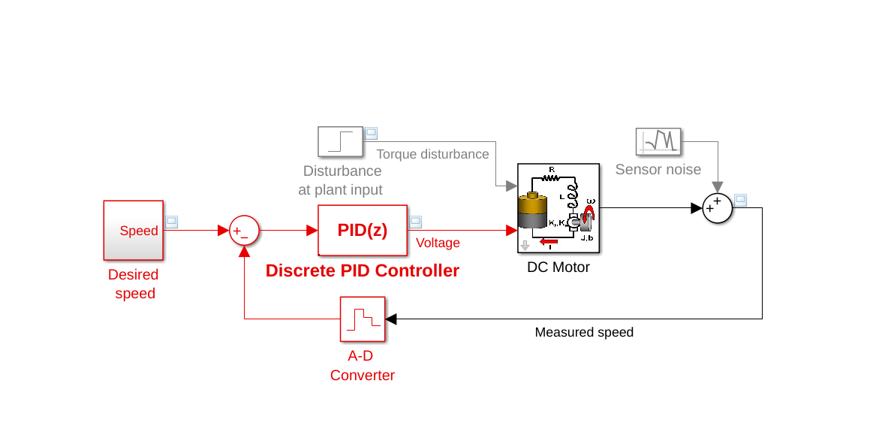
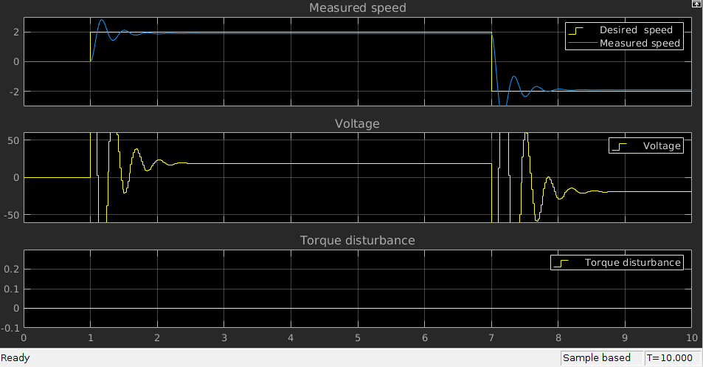
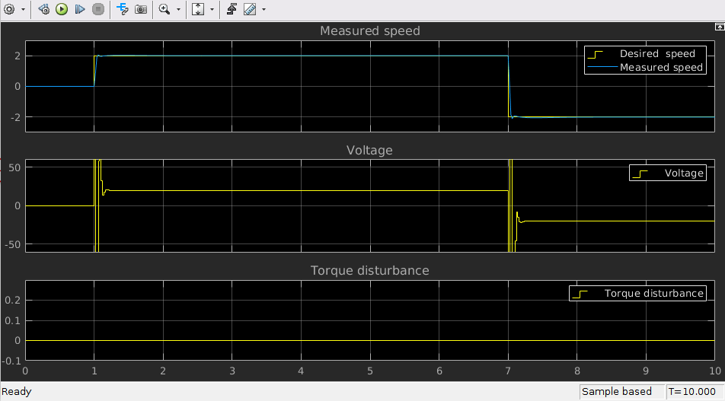
Concept of PID
Kp = 179
Kp = 179
Ki = 399
Kd = 16

Slide 26

Concept of PID

Slide 27
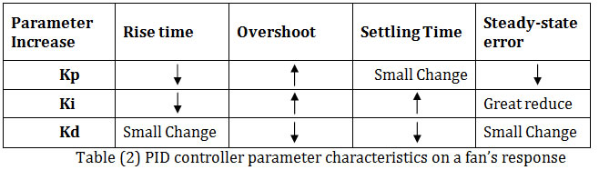
Tuning PID Parameters

Slide 28
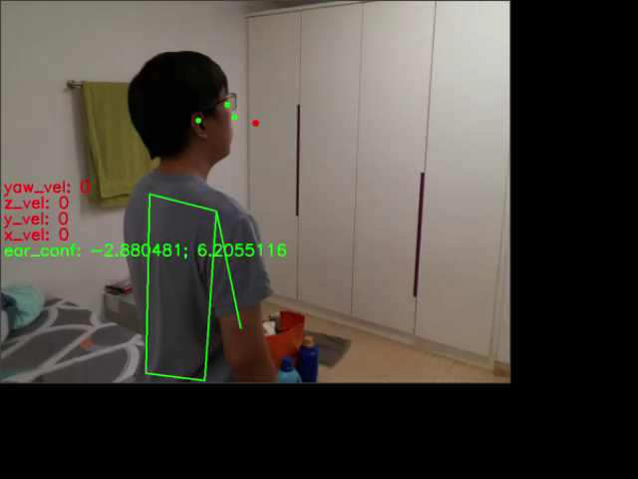
PID in action

Slide 29
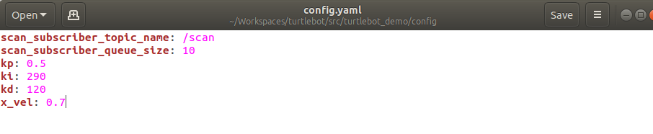
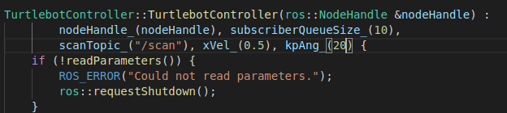
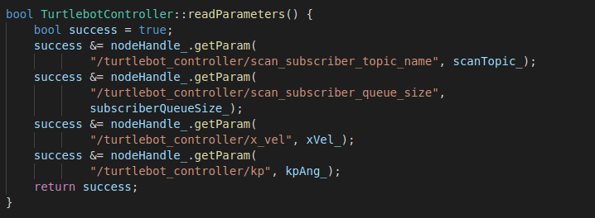
ROS Param
Define variables in a .yaml file
Does not require compiling(catkin_make / catkin build)

Slide 30
Hands-on!
Notes:
Distribute cheatsheet!

Slide 31
Hands-On! (things to be demoed)
How to subscribe to Laserscan messages
How to build a PID Controller to control your robot

Slide 32
https://github.com/Kenthoward20/Turtlebot.git
Notes:
Distribute cheatsheet!

Slide 33
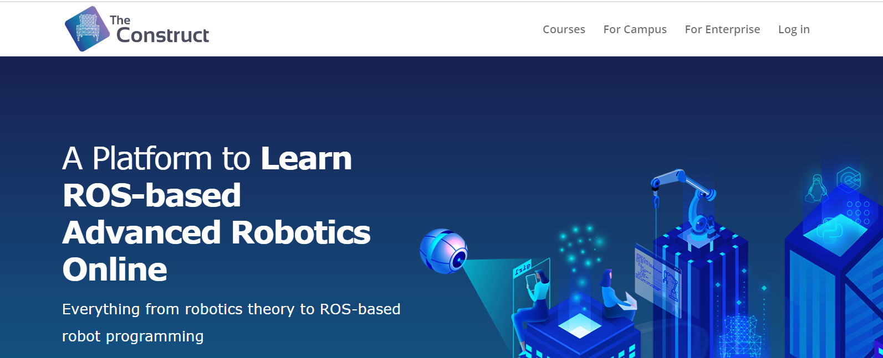
What platform will we use?
https://www.theconstructsim.com/

Slide 34
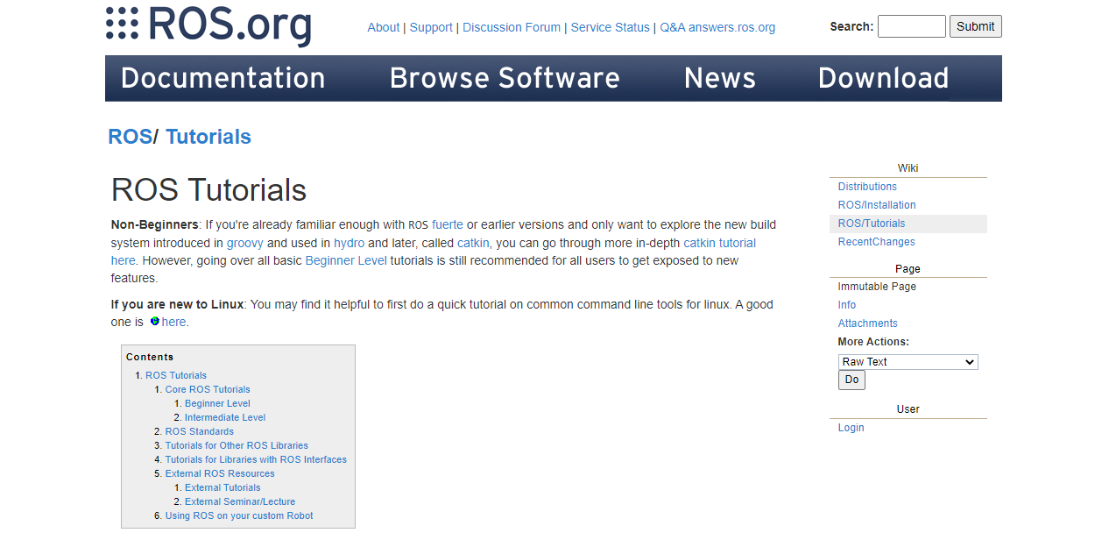
ROS Wiki & Official Guides
Notes:
Refer to official Wiki, documentation online! They will be useful I promise

Slide 35
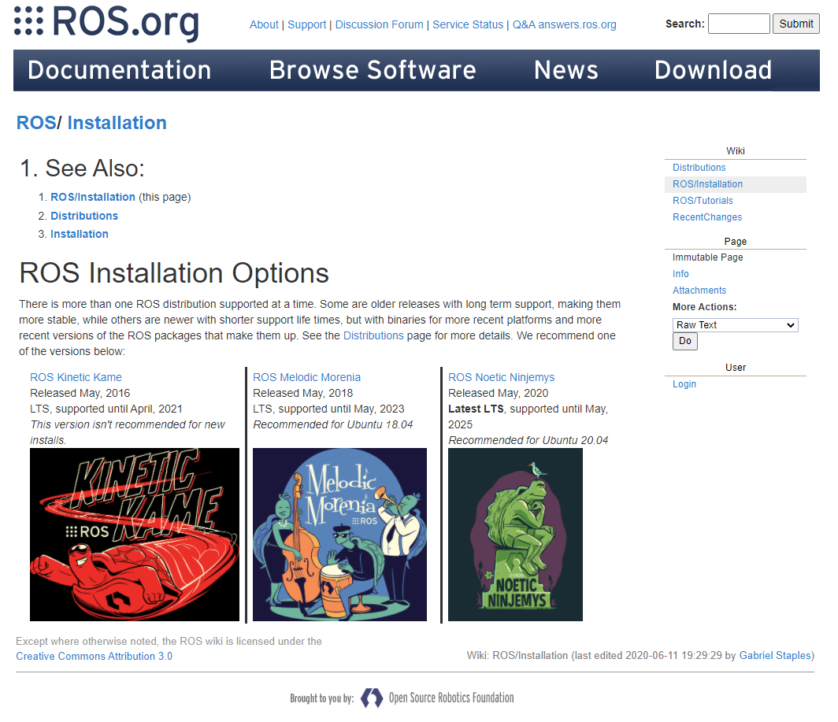
How to install normally?

Slide 36
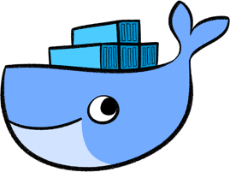


How to install normally?

Slide 37
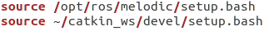
ConstructSim vs Local Installation
Need to run Ubuntu
Need to install ROS, required dependencies, Catkin tools
Need to create your own workspace (e.g. catkin_ws)
Need to source ROS and catkin_ws
Does NOT need internet connection (unless you want to communicate with other robots or the robot needs it)
And of course… way faster than ConstructSim!

Slide 38

Photo Session!
Please turn on your camera!

Slide 39
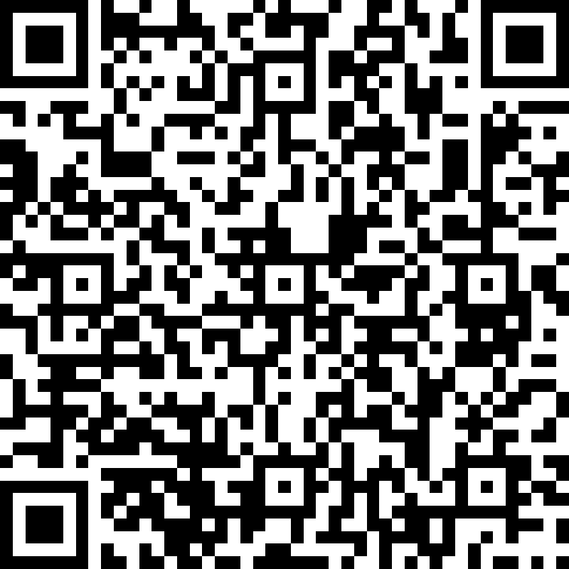
Thank You!
More ROS workshops from us coming soon!
https://forms.office.com/r/Q47EU668H8

